Slide 1

Geometry
Unit 8, Lesson 7 Trapezoid Midsegment Theorem Volume 2, pg. 42

Slide 2


Benchmark
MA.912.GR.1.5
Prove relationships and theorems about trapezoids. Solve mathematical and real-world problems involving postulates, relationships, and theorems of trapezoids.
volume 2, pg. 42

Slide 3
Integrated Mathematical Thinking and Reasoning Standards
MA.K12.MTR.1.1 Actively participate in effortful learning both individually and collectively.
MA.K12.MTR.2.1 Demonstrate understanding by representing problems in multiple ways.
MA.K12.MTR.3.1 Complete tasks with mathematical fluency.
MA.K12.MTR.4.1 Engage in discussions that reflect on the mathematical thinking of self and others.
MA.K12.MTR.5.1 Use patterns and structure to help understand and connect mathematical concepts.
MA.K12.MTR.7.1 Apply mathematics to real-world contexts.
volume 2, pg. 42

Slide 4

Learning Targets
I can prove the trapezoid midsegment theorem.
I can use properties of trapezoids to solve mathematical and real-world problems.
volume 2, pg. 42

Slide 5

Warm-Up
volume 2, pg. 43

Slide 6
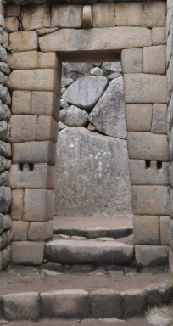
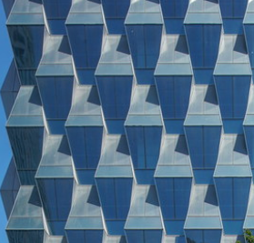
8.7.1 Warm-Up: Trapezoids in Architecture
Four different buildings are shown.
Machu Picchu, Peru | Greenland Center, Beijing, China
volume 2, pg. 43

Slide 7
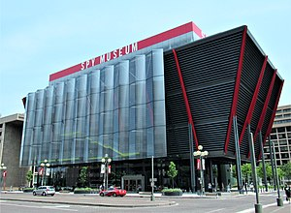
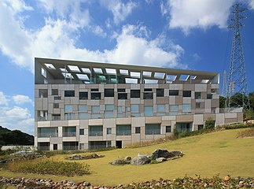
Garden Terrace, Nagasaki | International Spy Museum, Washington D.C.
What do you notice about the buildings?
Describe how a trapezoid is used in each building.
volume 2, pg. 43

Slide 8

Exploration
volume 2, pg. 43

Slide 9

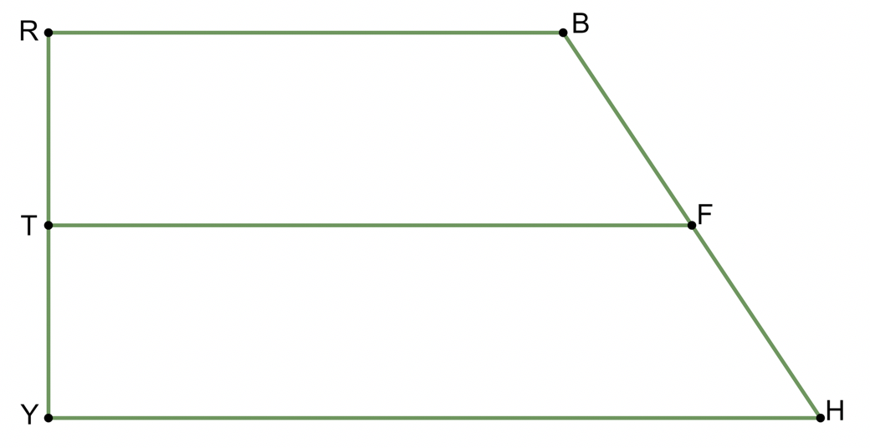
8.7.2 Exploration: Midsegment of a Trapezoid
Trapezoid $RBHY$ is shown, where $\overline{RB}∥\overline{YH}$.
volume 2, pg. 43

Slide 10
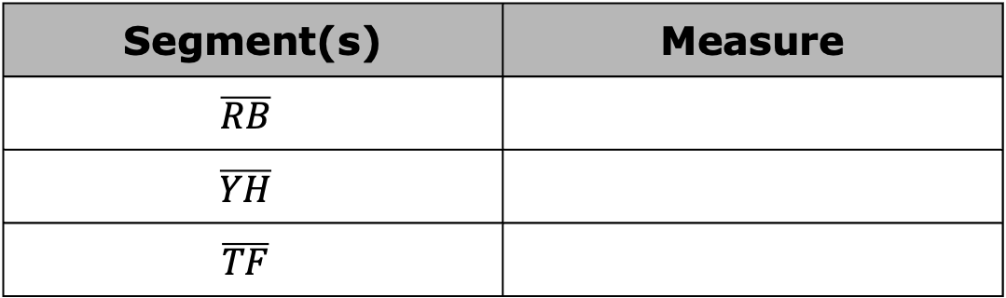
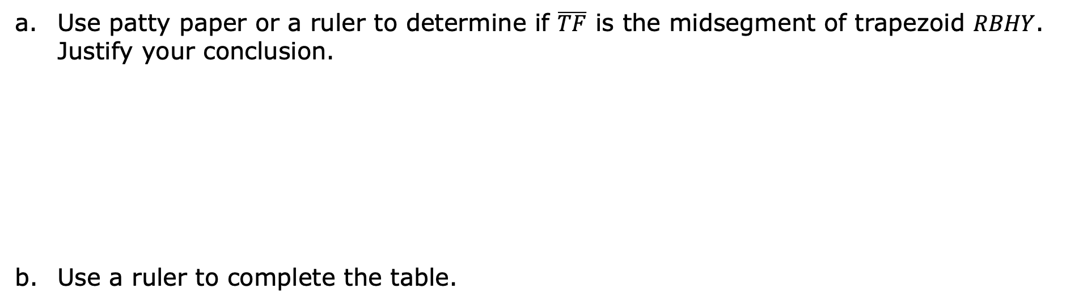
Use patty paper or a ruler to determine if $\overline{TF}$ is the midsegment of trapezoid $RBHY$. Justify your conclusion.
Use a ruler to complete the table.
Segment(s) | Measure
$$\overline{RB}$$
$$\overline{YH}$$
$$\overline{TF}$$
volume 2, pg. 43

Slide 11
What do you notice about the relationship between the length of the midsegment and the sum of the lengths of the bases?
Write an equation to show the relationship between the length of the midsegment of a trapezoid and the length of its bases.
volume 2, pg. 44

Slide 12

Guided Instruction
volume 2, pg. 44

Slide 13
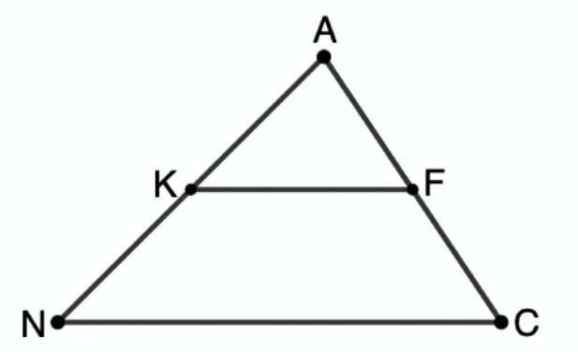
8.7.3 Guided Instruction: Trapezoid Midsegment Theorem
The midsegment of a triangle is a segment joining the midpoints of two sides of a triangle.
$∆ACN$ is shown with midsegment $\overline{KF}.$
Fill in the blanks to complete the triangle midsegment theorem.
The triangle midsegment theorem states that the midsegment of a triangle is ____________ to the third side it does not touch and is ________ the length of the third side.
volume 2, pg. 44

Slide 14
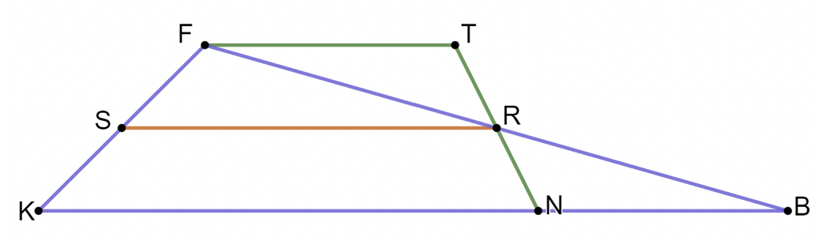

$∆FBK$ with midsegment $\overline{SR}$ and trapezoid $FTNK$ are shown where $\overline{FT}∥\overline{KN}$.
Explain why $SF=KS$.
If $\overline{NB}≅\overline{FT}$, justify why $\overline{NR}≅\overline{RT}$.
Discuss with your partner what information is necessary so that the definition of a trapezoid can be used to state that $FTRS$ is a trapezoid. Summarize your discussion.
volume 2, pg. 45

Slide 15

Discuss with your partner what else needs to be determined so that it can be stated that $\overline{SR}$ is a midsegment of $FTNK$. Summarize your discussion.
Trapezoid Midsegment Theorem
The midsegment of a trapezoid is parallel to the bases and is half the sum of the bases.
volume 2, pg. 45

Slide 16

Guided Practice
volume 2, pg. 46

Slide 17

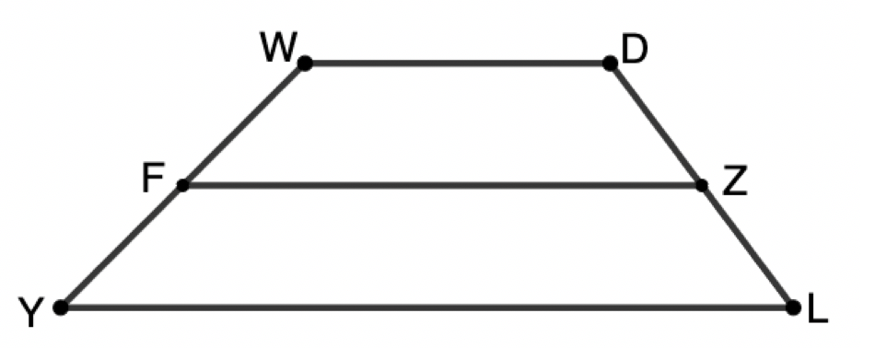

8.7.4 Guided Practice: Using the Trapezoid Midsegment Theorem
Trapezoid $WDLY$ with midsegment $\overline{FZ}$ is shown.
If $WD=14.2$ and $YL=29.7$, what is the length of $\overline{FZ}$?
If $WDLY$ is an isosceles trapezoid and $m∠DLY=53°$, what is $m∠WFZ$?
volume 2, pg. 46

Slide 18
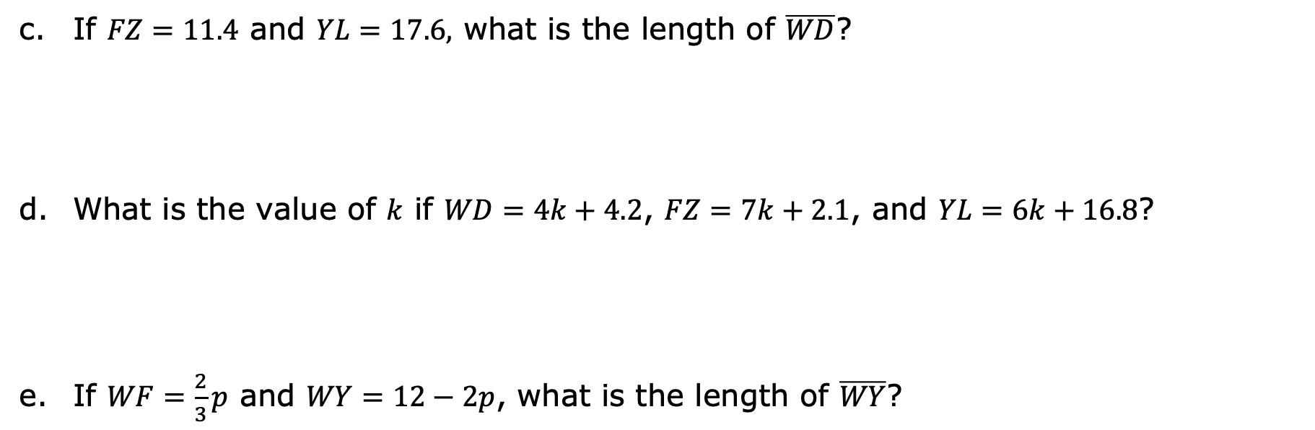
If $FZ=11.4$ and $YL=17.6,$ what is the length of $\overline{WD}$?
What is the value of $k$ if $WD=4k+4.2$, $FZ=7k+2.1$, and $YL=6k+16.8$?
If $WF=\frac{2}{3}p$ and $WY=12−2p$, what is the length of $\overline{WY}$?
volume 2, pg. 46

Slide 19

Your Turn
volume 2, pg. 47

Slide 20
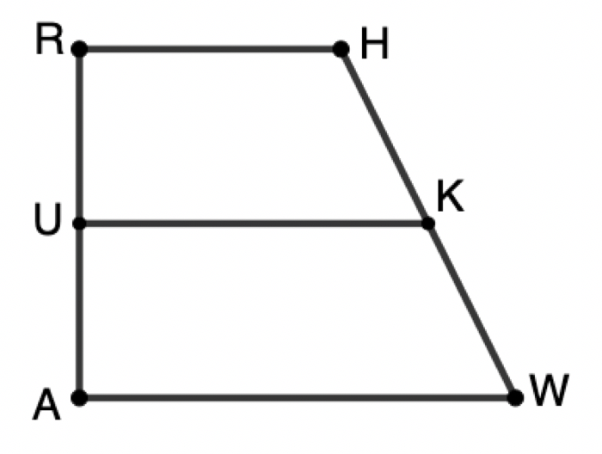
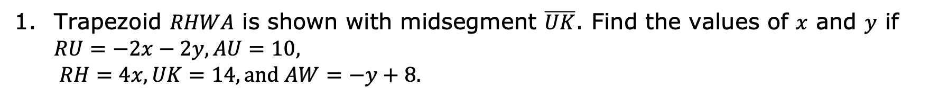
8.7.5 Your Turn!
Trapezoid $RHWA$ is shown with midsegment $\overline{UK}$. Find the values of $x$ and $y$ if $RU=−2x−2y, AU=10,$
$$RH=4x, UK=14, and AW=−y+8.$$
volume 2, pg. 47

Slide 21
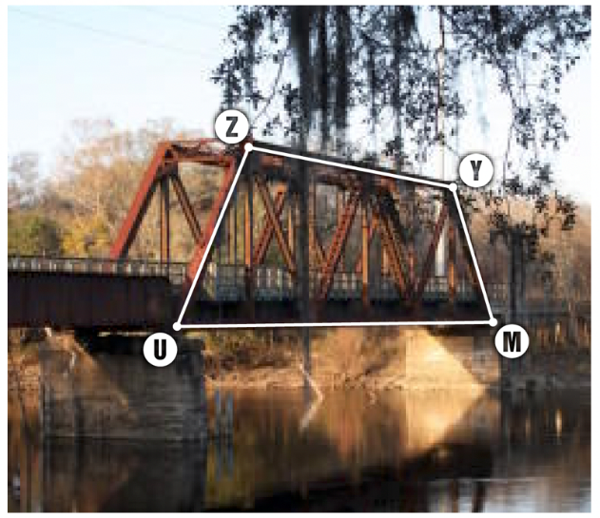
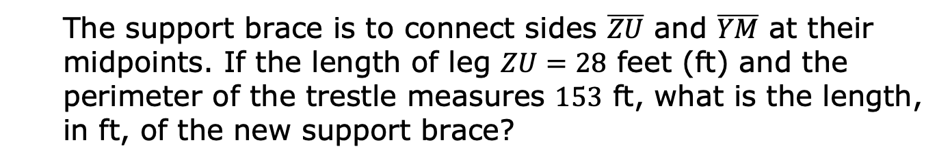
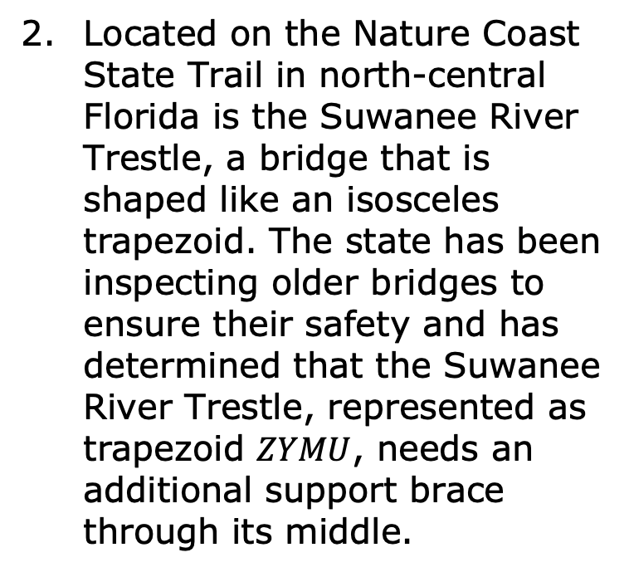
Located on the Nature Coast State Trail in north-central Florida is the Suwanee River Trestle, a bridge that is shaped like an isosceles trapezoid. The state has been inspecting older bridges to ensure their safety and has determined that the Suwanee River Trestle, represented as trapezoid $ZYMU$, needs an additional support brace through its middle.
The support brace is to connect sides $\overline{ZU}$ and $\overline{YM}$ at their midpoints. If the length of leg $ZU=28$ feet (ft) and the perimeter of the trestle measures $153$ ft, what is the length, in ft, of the new support brace?
volume 2, pg. 47

Slide 22

Wrap-Up
volume 2, pg. 48

Slide 23
8.7.6 Wrap-Up: Cool Down
Your friend is absent today and will need the notes from class. Write a quick note to help them understand the trapezoid midsegment theorem.
volume 2, pg. 48

